Slide 1

Presentation on Online Municipality Complaint Management for smart city
BIRLA INSTITUTE OF TECHNOLOGY,MESRA
EXTENSION CENTRE LALPUR,RANCHI

Slide 2
Online Municipality Complaint Management for Smart city
PRESENTED BY:
1. SHAHINA NAAZ KHAN BCA/40066/18 2. ARCHANA BARWA BCA/40071/18 3.VARTIKA VISHWAKARMA BCA/40075/18 4.PRERNA KUMARI BCA/40076/18 5.SALONI KUMARI BCA/40080/18
PRESENTED TO: PARTHA SARATHI BISHNU SIR
GUIDED BY: ONIMA TIGGA MA’AM

Slide 3
Outline
OBJECTIVE
1.
EXISTING SYSTEM.
3.
PROPOSED SYSTEM
2.
IMPLEMENTATION.
4.
5.
CONCLUSION

Slide 4
Project Objective
.
Online Complaint Management System provides an online way of solving the problems faced by the public by saving time and eradicate corruption.
The objective of the complaints management system is to make complaints easier to coordinate, monitor, track and resolve, and to provide company with an effective tool to identify and target problem areas, monitor complaints handling performance and make business improvements.
Online Complaint Management is a management technique for assessing, analyzing and responding to customer complaints.

Slide 5
Existing System
In the existing system the people must go to the office for any kind of help.
The users can post their problems but cannot get the details of the problems and some other services.
This system doesn’t have much popularity and is not user friendly.

Slide 6
Proposed System
The Complaint Management System is one of the most significant and resource intensive project in which proposed system the citizen need not go to the government office for getting his problem solved. He can get his problem solved by posting his problem in this proposed system thus is to encourage and assist public sector and he can suggest a possible solution to the problems posted on the system. He can even get the information of the funds and other details of his place in detail through this system.

Slide 7
.
Our proposed system provides solution to existing system by extending its facilities as follows:
• Registration is provided so that officer can solve the problems easily
• Complete information regarding the place is displayed.
• Can suggest a solution for solving the problems in a better way,
• Can comment on the government’s decisions.

Slide 8
IMPLEMENTATION In this system there are two modules :
USER
ADMIN

Slide 9
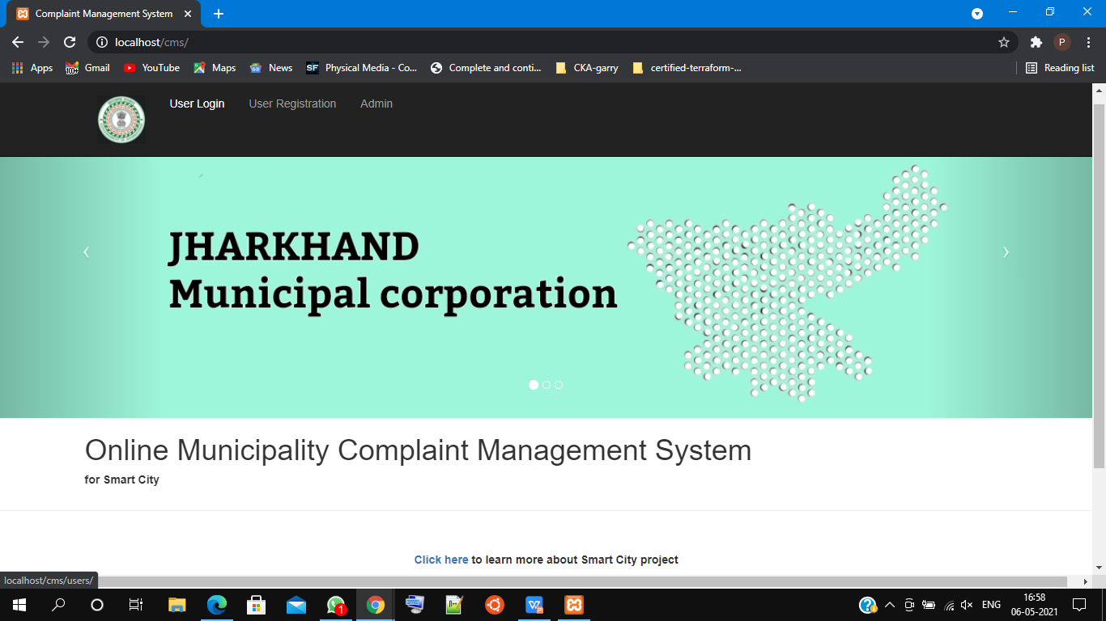

Slide 10
USER MODULE
In user module people can visit the web page, where user will log in with their email Id provided and password, if they don’t have account , they must first register themselve.
The information about the municipality and the instruction to register the complaint has been specified,
The form contains nature of compliant,complaint category, sub category, and also for include image and any document for the complaint , address where the area get affected.
The person who complaints in the online can receive the notification on the web page (the successful registration) it intimates that the complaint has been stored in the database.
The dashboard will show the status of the complaints.

Slide 11
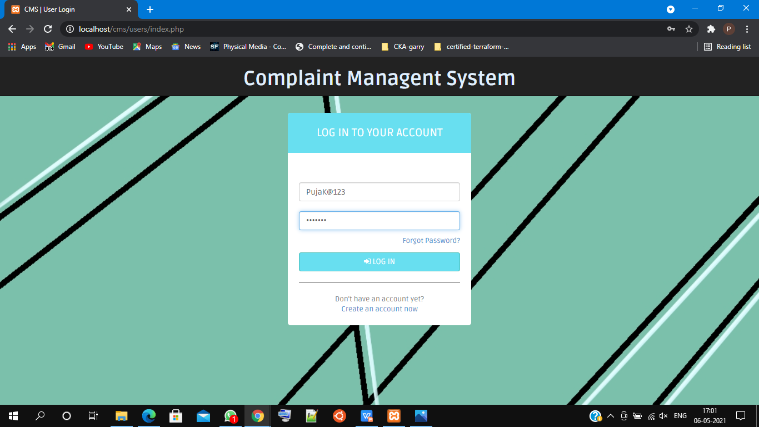
USER LOG IN

Slide 12
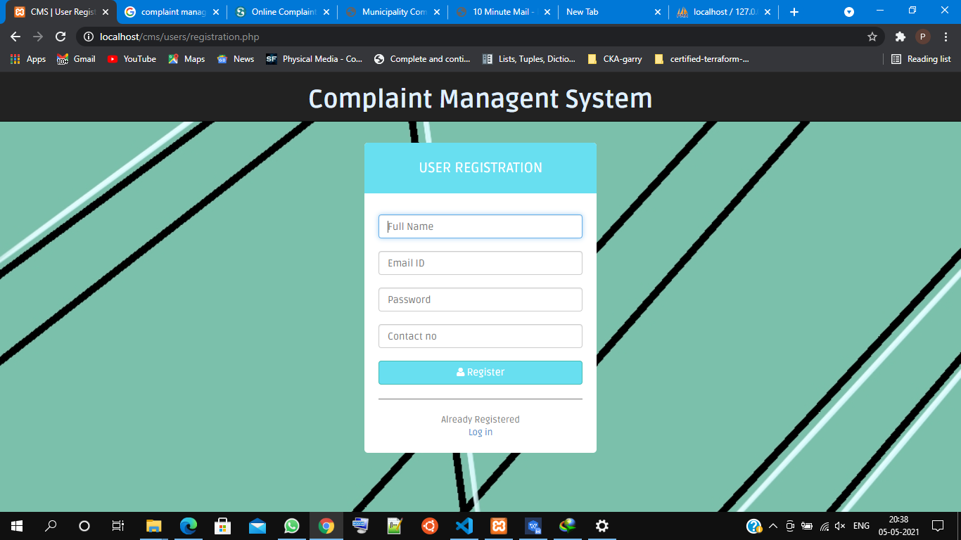
USER REGISTRATION

Slide 13
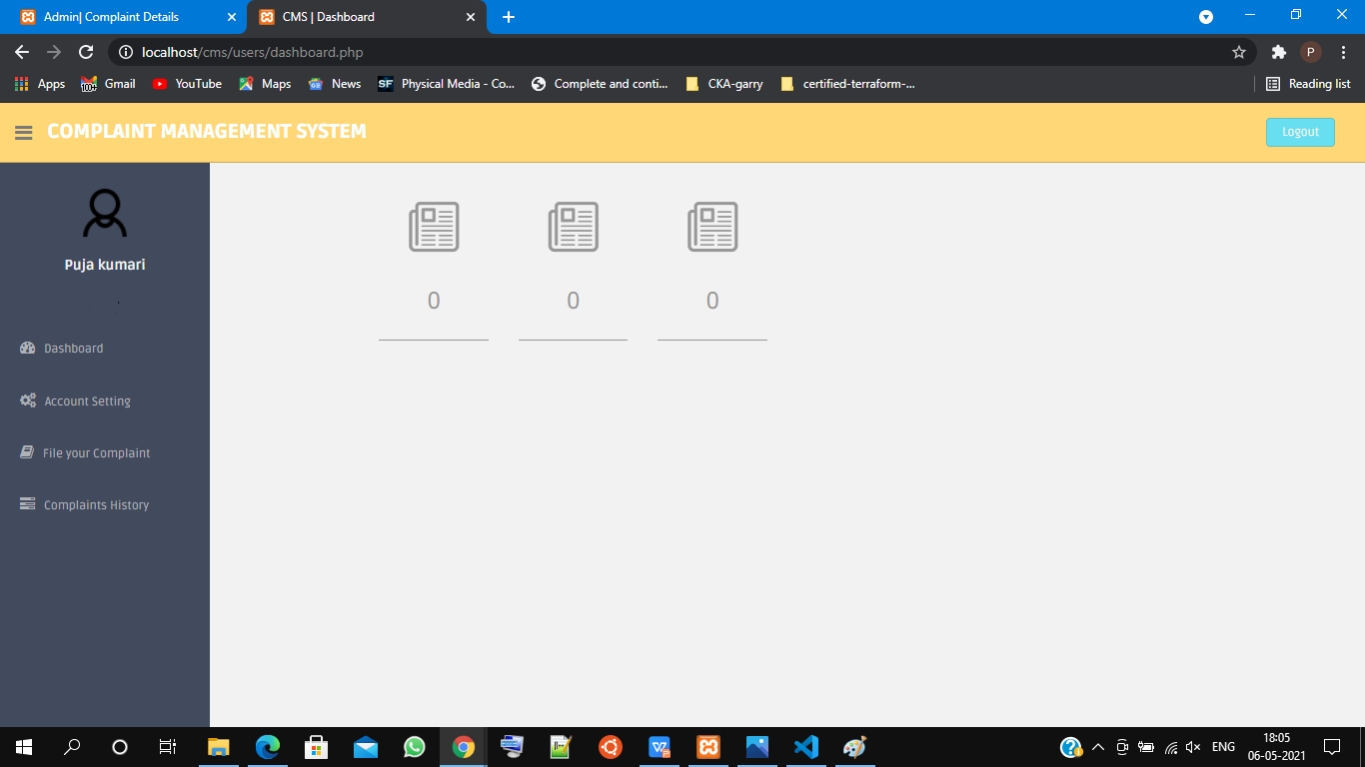

Slide 14
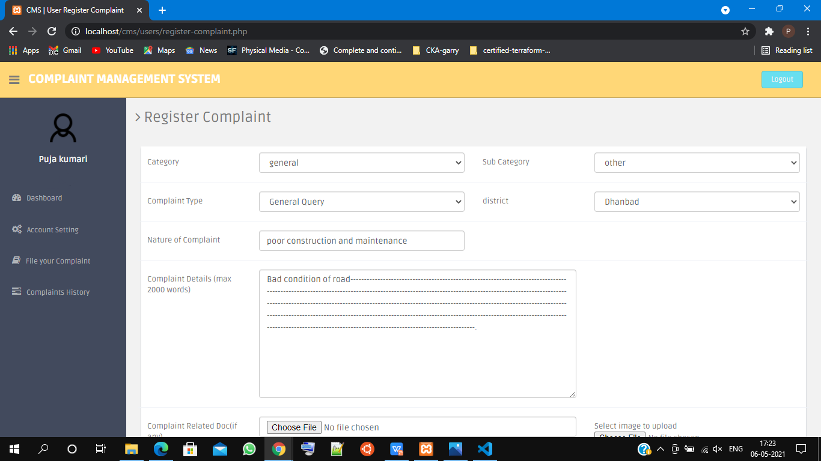
COMPLAINT REGISTRATION

Slide 15
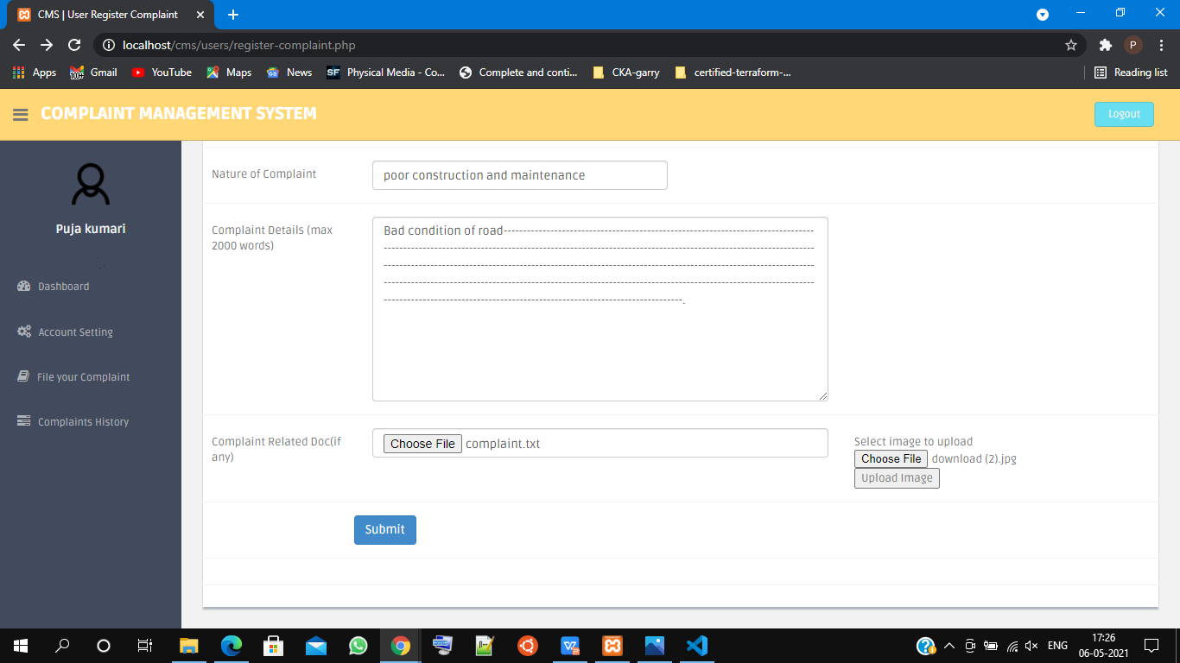

Slide 16
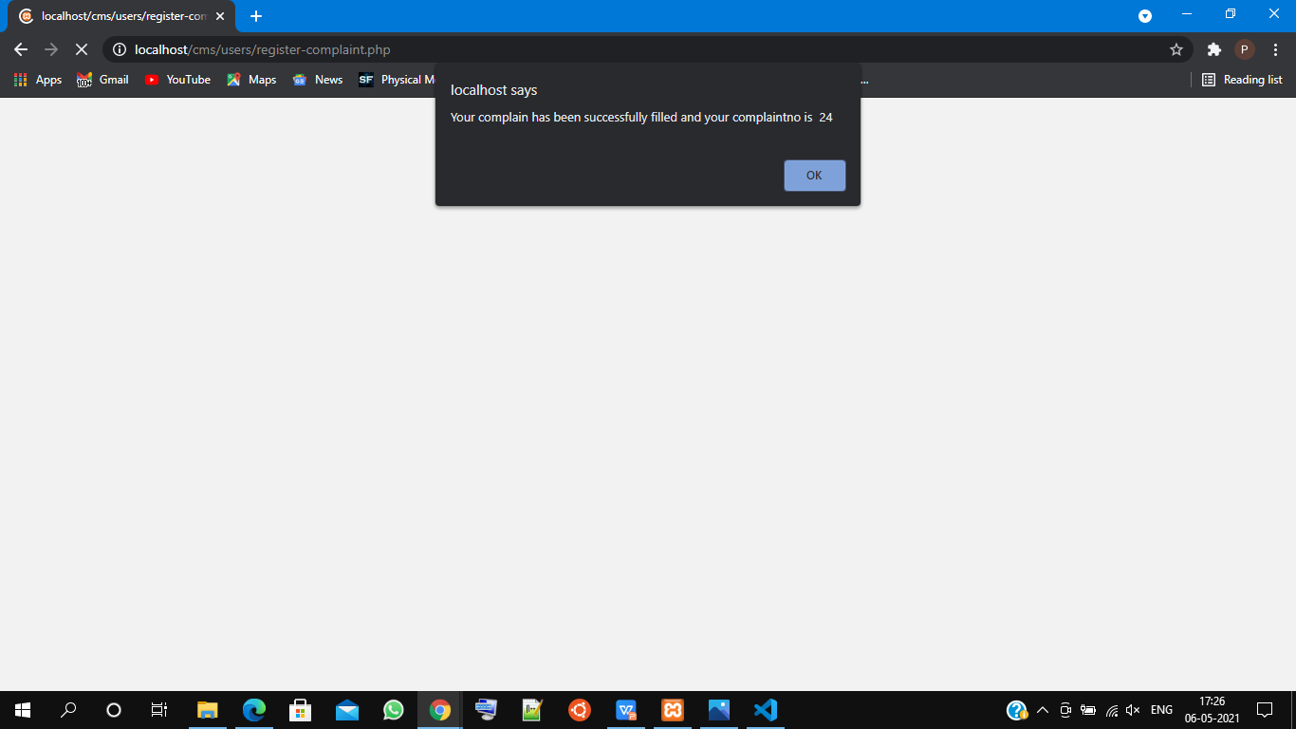
After clicking on submit button , this box will be shown with the message of successful submission.

Slide 17
ADMIN MODULE
At admin side the compliant has been stored in database,the information about the complaint has been identified and recovered atthe case of multiple problems register at a time can be resolved according to the priority of the problem.

Slide 18
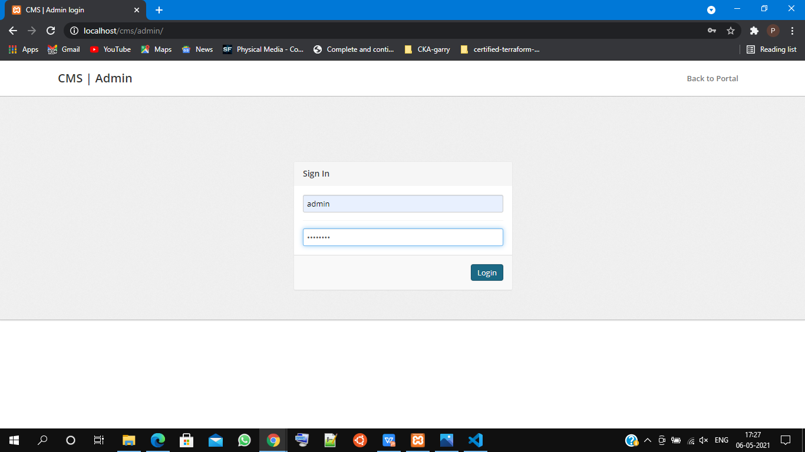
ADMIN LOG IN

Slide 19
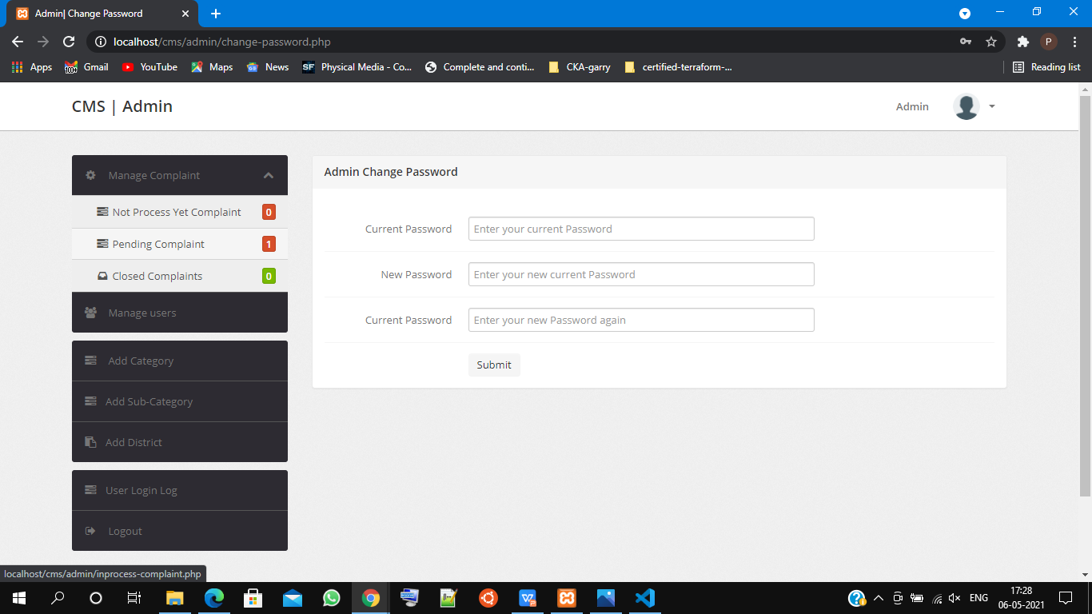
After a successful log in , Admin will bedirected to this page . Here he/she can change their password,and go throught the various options to manage the complaints and users.

Slide 20
CONCLUSION
In current system, complaint registration for government bodies is offline which consumes more time for registering the complaints. We successfully build a bridge between the Municipal Corporation and ordinary people through our application. Here the data’s were successfully mined deeply using spatial data mining algorithm which leads to significant progress in our application. Also, some more ease was given to the users through the Android front-end development. The minimization of the manual errors in the municipal department was the major part of our project which is successfully depicted

Slide 21
The proposed system has the following features:
Easy to use
There is not much procedures to be followed while registering the complaint and hence saving everyone’s valuable time too .
less time consumption
The user will not have to waste their time standing in long queue, since evrything is online.
User friendly
Users can add as much information as they want and they can also upload documents and images related to complaint .

Slide 22
……
THANK YOU

